Slide 1
Ant Colony Optimization algorithm design and its FPGA implementation
Shih-An Li, Min-Hao Yang, Chung-Wei Weng, Yi-Hong Chen, Chia-Hung Lo, Ching-Chang Wong

Slide 2
Abstract
A hardware/software co-design to implement ant colony optimization.
Increase efficiency against a pure software implementation
Less Power
Less Space
Less Time

Slide 3
Ant Colony Optimization
A method of determining the best path when multiple routes are available
Inspired by how live ants are able to find the best route between their nest and a food source
Achieved through the use of pheromone trails
Subject to a degree of probability but should identify the shortest path most of the time

Slide 4
Any Colony Optimization
Originally based on ‘Ant System’ developed by Marco Dorigo in 1991 – Di Caro (2004)
When an ant approaches a choice of direction, it will be influenced by existing pheromone trails left by other ants
As the ant that has picked the shortest route will make it back to the nest in the shortest time, there will be the highest concentration of pheromones on that trail.

Slide 5
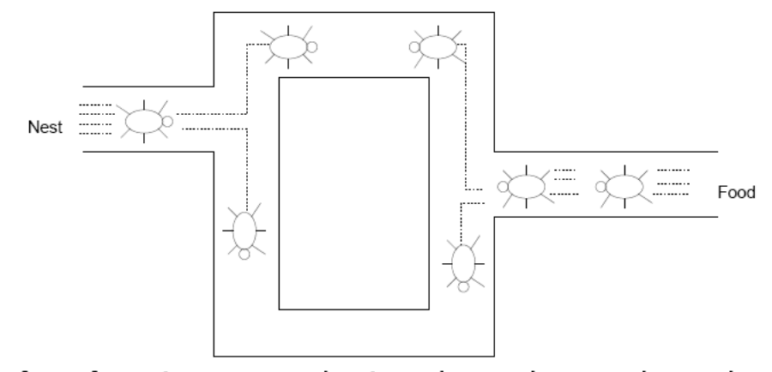
Any Colony Optimization
This will influence other ants, further reinforcing the trail
M. Herman (2010)

Slide 6
Ant Colony Optimization
This system is not perfect
Random probability can still cause selection and reinforcement of the wrong path
A change in environment (e.g. new paths appearing) are unlikely to be chosen and reinforced after initial selection

Slide 7
What is an FPGA
A field programmable gate array is an interconnected array of digital sub-circuits that can be reconfigured depending on the application – Keim (2018)
Allows for a bespoke processing pipeline to be implemented
Greater performance than software implementations
Allows for parallel execution of instructions
Not as fast as a dedicated ASIC

Slide 8
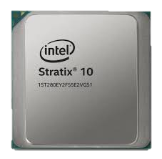
What is an FPGA
Traditional instructions can be executed on an FPGA through use of a soft processor that can be included in the design if space and resources are available
This allows for application control to be handled by the soft processor whilst resource intensive jobs are offloaded to digital logic that can be accelerated and parallelised as required
Intel (2018)

Slide 9
NIOS II
A 32-bit processor architecture for Altera FPGA family
Designed to co-exist and interface with other applications on the FPGA
Uses a RISC architecture

Slide 10
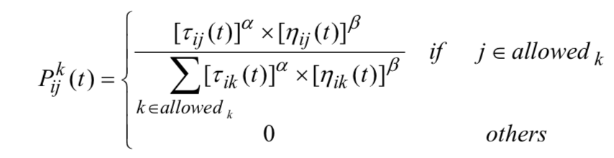
ACO Algorithm
The following formula can be derived based on an ants ability to:
1) Follow pheromone trails of other ants
2) Explore their environment
Giving the probability of a path being chosen
Shih-An Li (2012)

Slide 11
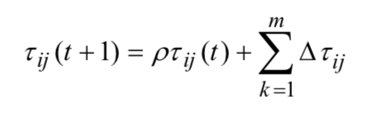
ACO Algorithm
Pheromones on a trail will be updated based on:
1) An increase through an ant passing over that trail
2) A decrease through environmental factors
Shih-An Li (2012)

Slide 12
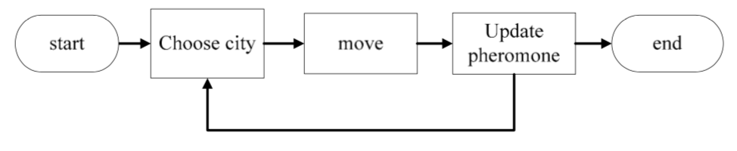
ACO Flow
The ACO algorithm primarily uses 5 states:
Shih-An Li (2012)

Slide 13
ACO Flow
At first, the initial ant positions are set, from there a path is chosen and a trip is started.
After completion, the length of the trip can be calculated and pheromones updated
The transition probability formula can they be used to determine the chance of a different path being chosen, over time reinforcing the shortest path

Slide 14
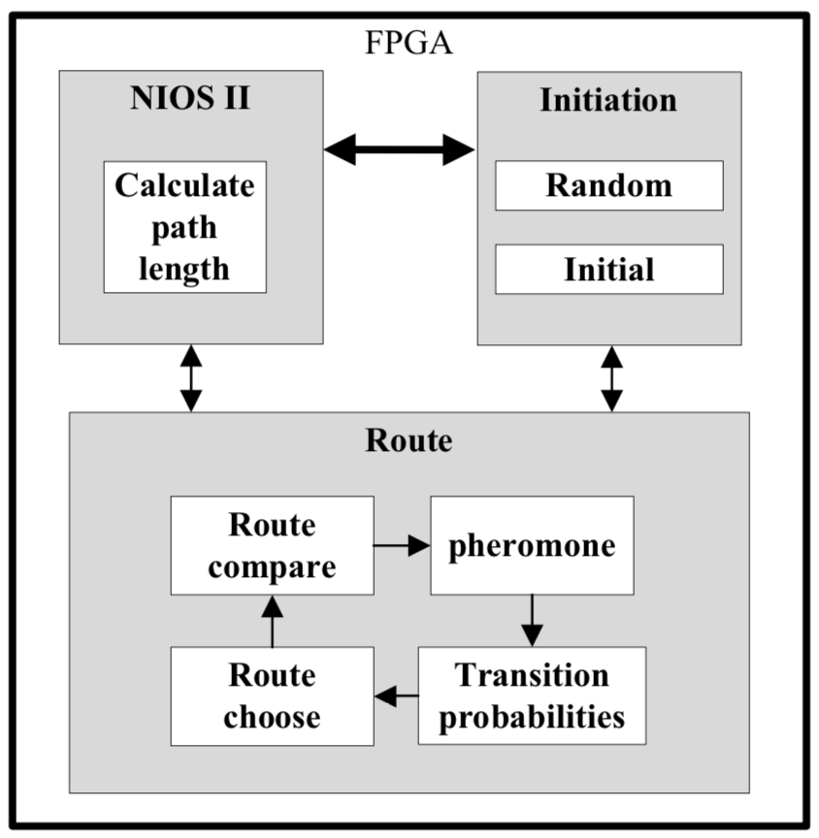
ACO Implementation
The ACO implementation on the FPGA can be broken down in to three distinct module.
Shih-An Li (2012)

Slide 15
ACO Implementation
Initiation Module
Used to set the initial variables including:
Number of iterations
Number of ants
Rate of pheromone dissipation
This also (unintuitively) includes the random number generator that is used during execution

Slide 16
ACO Implementation
Route Module
Contains a pheromone matrix with all pheromone concentration values of routes between nodes utilising a LUT to increase speed of operation
Contains the pheromone update implementation to determine new pheromone values
Contains a route choose circuit that utilises the random number generator and pheromone matrix to determine if a route is picked

Slide 17
ACO Implementation
NIOS II Module
A NIOS II soft-core processor is used for the following functions:
Determine absolute path length
Determine best path

Slide 18
Results
Limited testing and performance analysis
The follow initialisation parameters were used:
Nodes: 31
Ants: 31
Iterations: 200

Slide 19
Results
Design Approach | Initialisation Time | Path Choose Time
Software | 0.7380s | 0.4369
Hardware Accelerated | 0.01440 | 0.0459

Slide 20
Questions

Slide 21
References
Li, S., Yang, M., Weng, C., Chen, Y, Lo, C, Wong, C. (2012) Ant Colony Optimization algorithm design and its FPGA implementation. 2012 IEEE International Symposium on Intelligent Signal Processing and Communication Systems. pp. 262-265.
Di Caro, G. (2004) Ant Colony Optimization and its Application to Adaptive Routing in Telecommunication Networks. PhD, Universite´ Libre De Bruxelles.
Herrmann, M. (2010) Lecture 10: Ant Colony Optimisation, The University of Edinburgh. 21 October.
Keim, R. (2018) What Is an FPGA? An Introduction to Programmable Logic. Available from: https://www.allaboutcircuits.com/technical-articles/what-is-an-fpga-introduction-to-programmable-logic-fpga-vs-microcontroller/[Accessed 21 November 2018].

